Slide 2
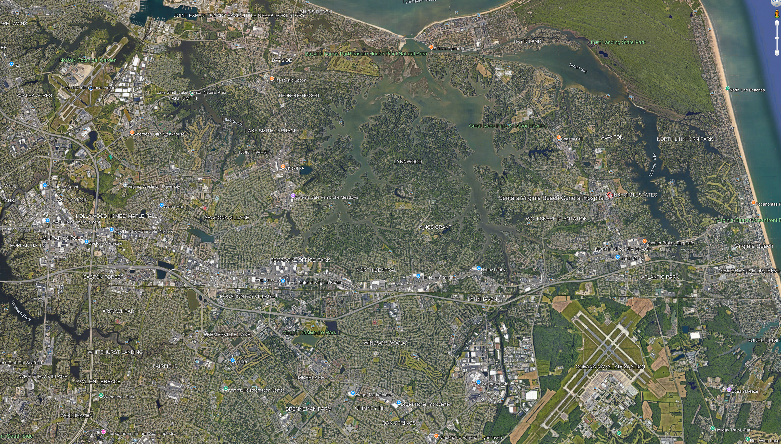
ORF
Kings
General
Convention
Westin

Slide 3
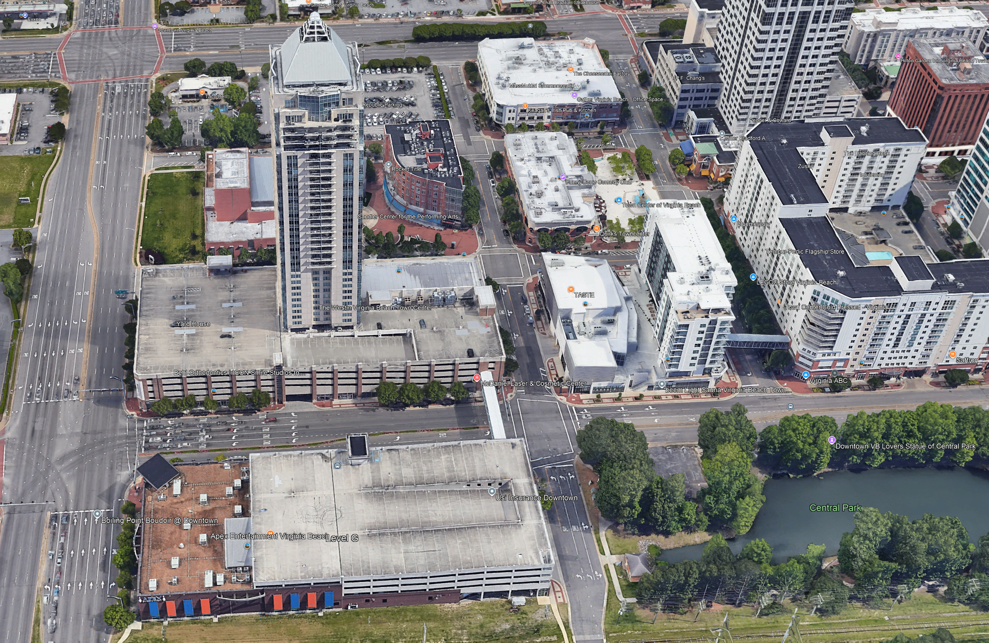
Westin
36:50:29
76:08:09

Slide 4
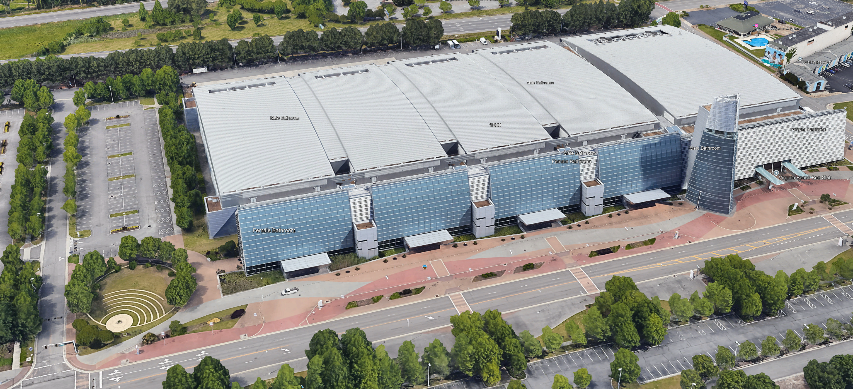
Convention
36:50:42.5
75:59:20.25

Slide 5
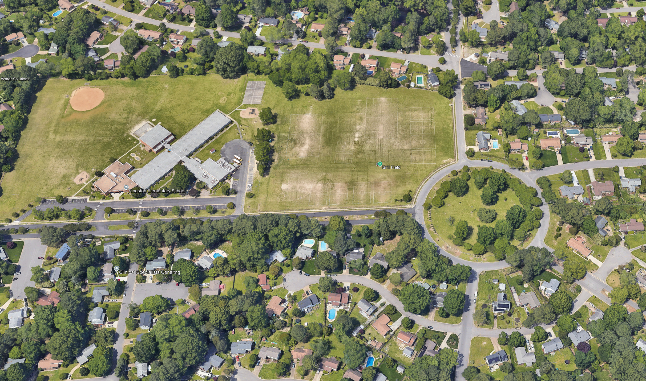
Kings
36:51:40.5
76:05:28

Slide 6
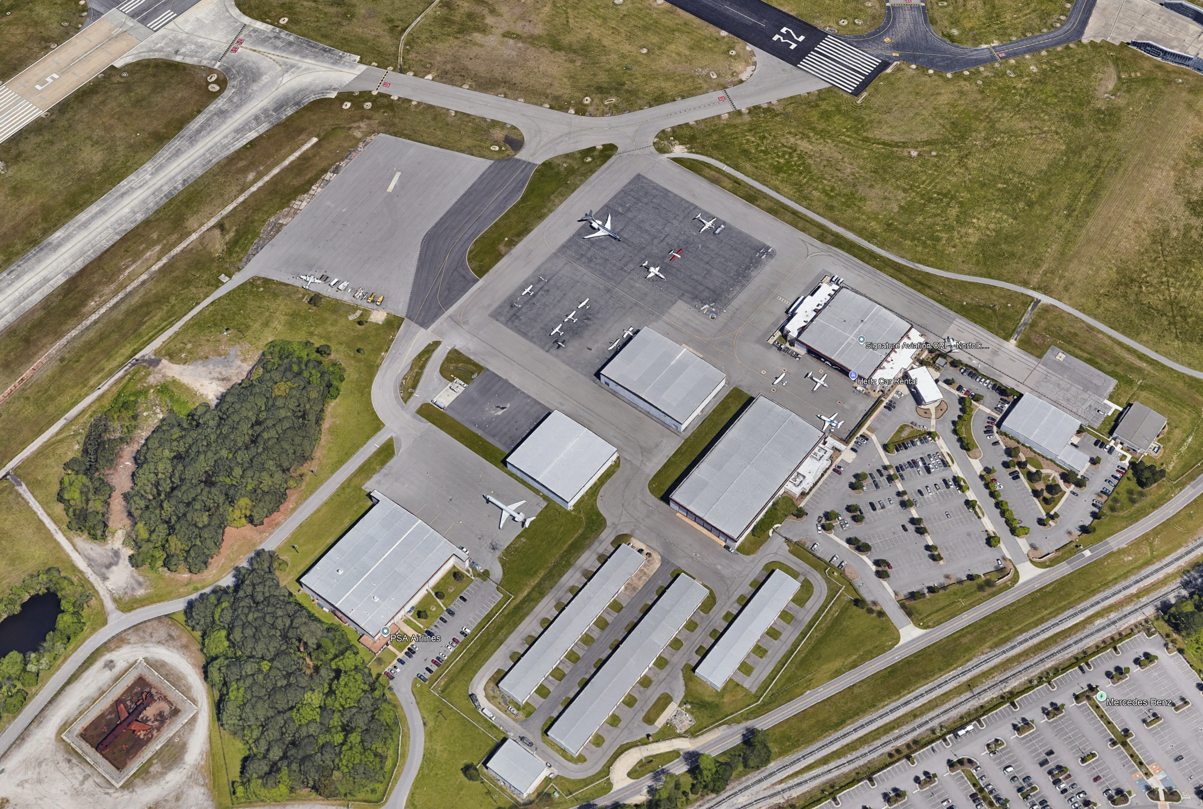
ORF
36:53:14.6
76:12:10

Slide 7
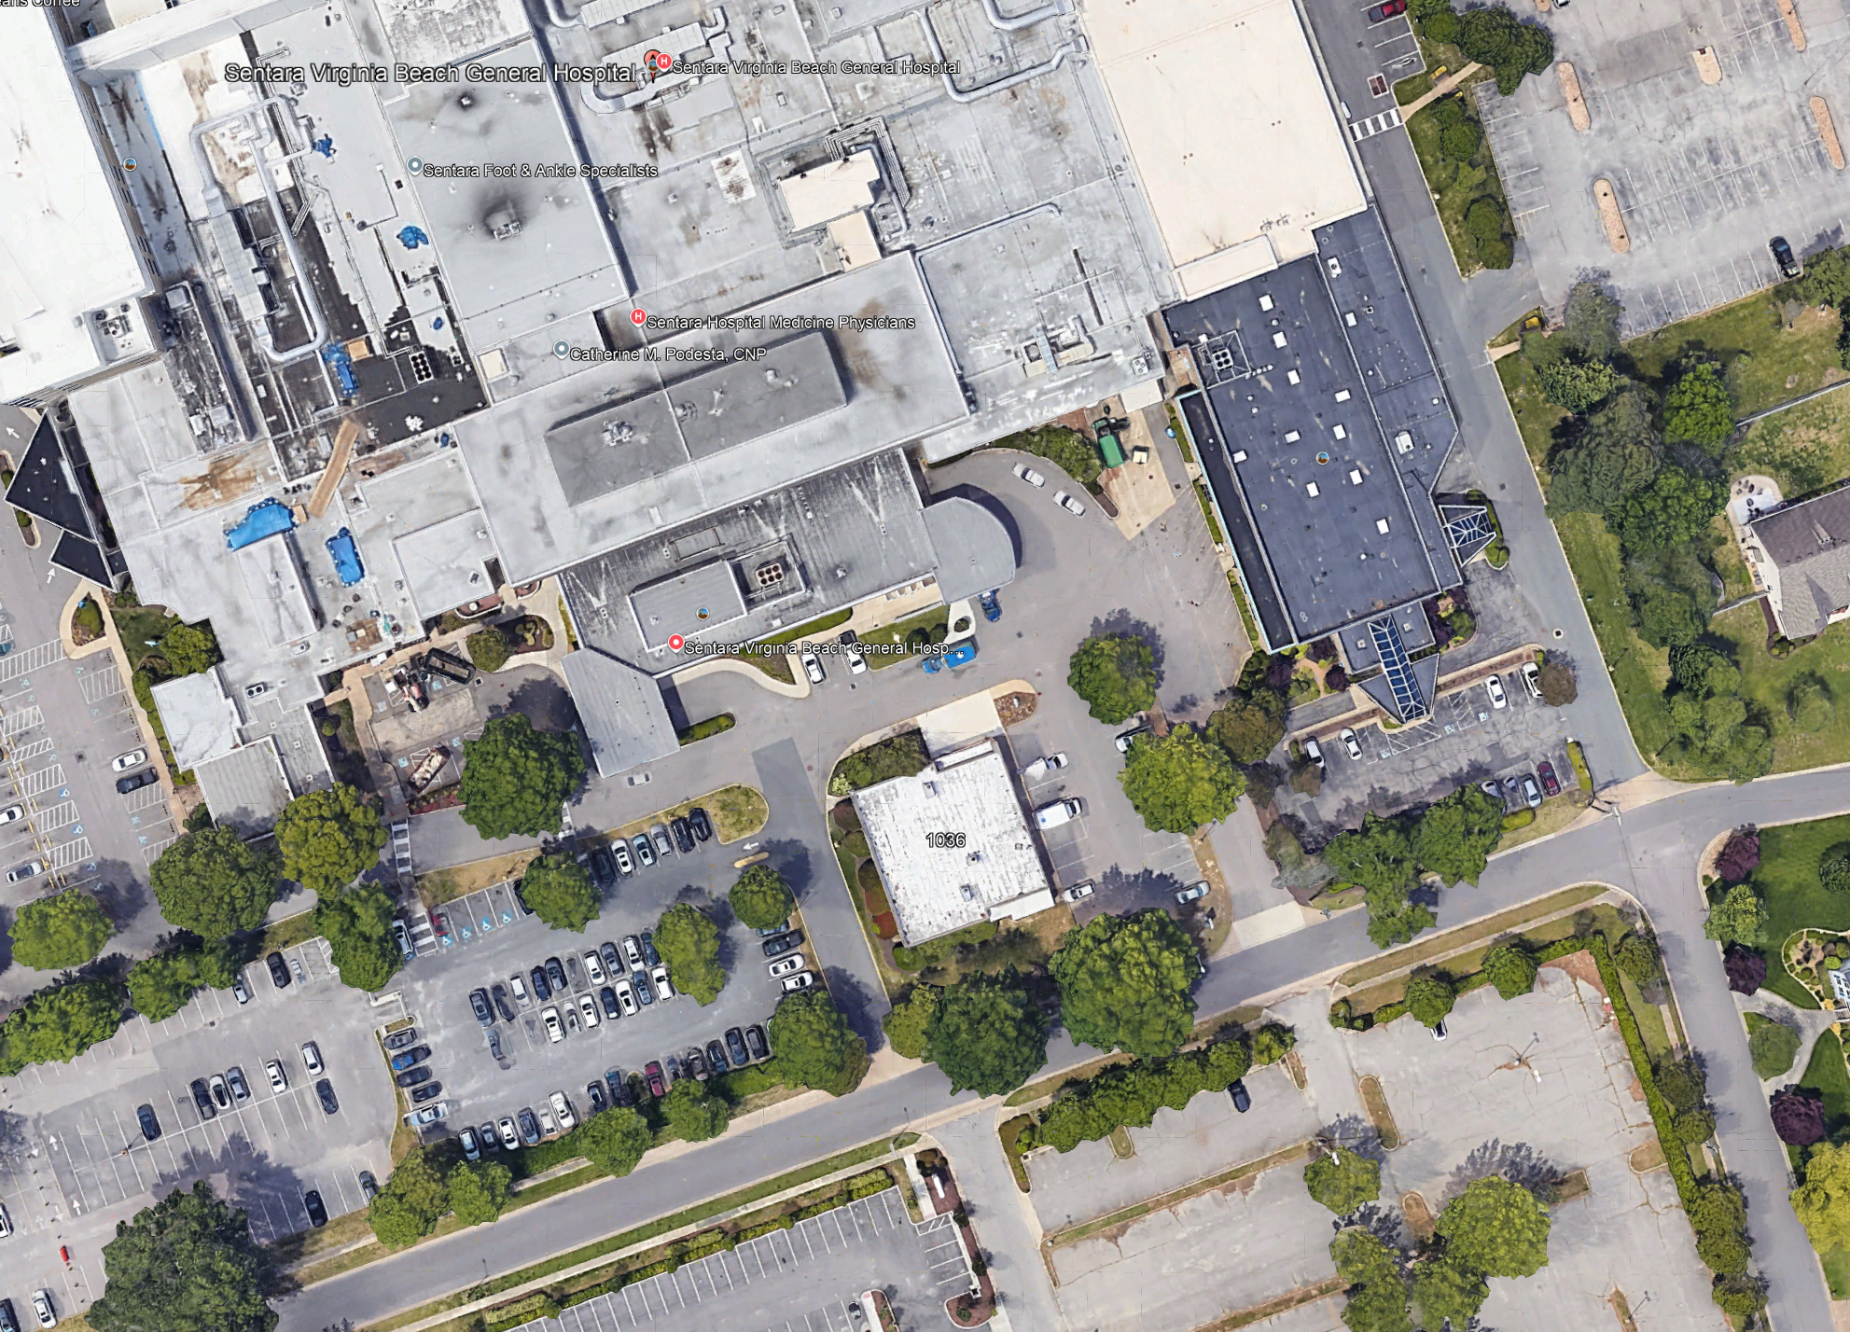
General
36:51:49.7
76:01:32.8

