Slide 1
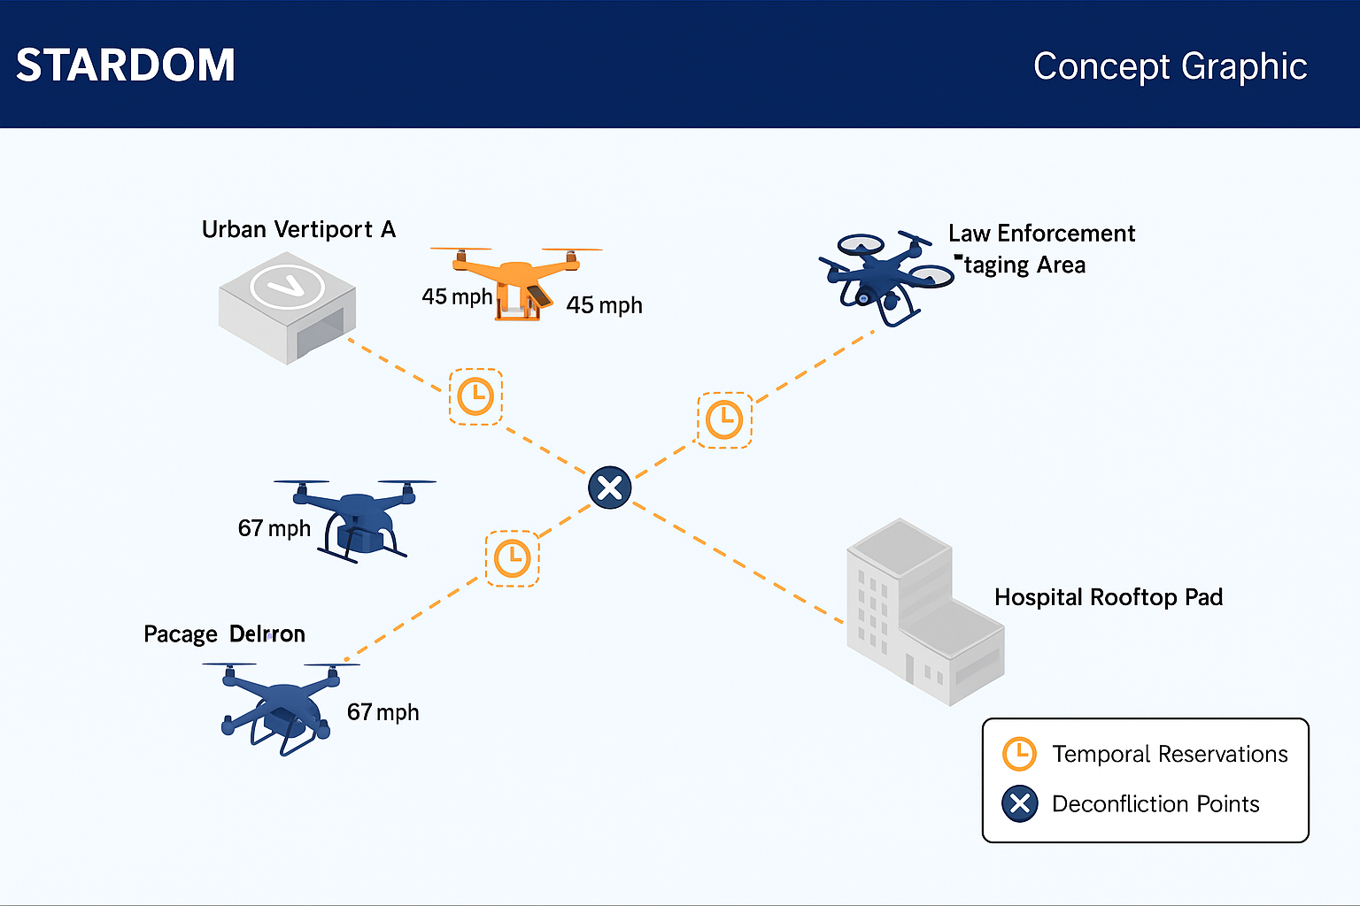
Safe Temporal Assignment Requirements Deconfliction and Optimization Model (STARDOM)
NASA SBIR - Phase I Update Meeting w/NASAs Technical Monitor
20 November 2025
Notes:
These charts provide an update of our progress on the NASA SBIR Phase 1 STARDOM effort—the Safe Temporal Assignment, Requirements, Deconfliction and Optimization Model.
1

Slide 2
Overview
Introductions
STARDOM Overview
STARDOM Progress
STARDOM Demonstration
Sponsor Input / Feedback
Next Steps
Notes:
We'll start with introductions, provide a brief overview of the STARDOM Concept and the progress made to date. Then we, then move on to a Demonstration of what we’ve developed using our @Risk software tool. Most Importantly, we invite your input and feedback on what we’ve done to date, and solicit any expectations you may have to help guide our future work. Finally, we'll culminate with Next Steps.

Slide 3
Introductions
CS Core Team
  Dennis Rowe, PI
  Alan Bell, OR SME
  Michael Hawrysko, ATC/UAS SME
Other CS Key Players
  Jason Cunha, VP Aerospace
  Kevin Schweer, CGO
  Bill Wright, CTO
  Steven Butler, Contracts Mgr.
NASA’s Technical Monitor
  Daniel Hulse, TM/COTR

Slide 4



STARDOM: Overview
Develop and demonstrate a temporal reservation & deconfliction model that manages demand with quantified safety risk.
Apply probabilistic risk management to measure tradeoffs between safety and efficiency in a UAM environment.
Deliver a prototype with representative scenarios demonstrating application of the STARDOM concept.
Notes:
Our Phase I goal in STARDOM is to develop and demonstrate a capability that optimizes time-of-arrival assignments with quantified safety risk. We plan to demonstrate this in representative scenarios, using benchmark metrics such as throughput, average & 95th percentile metrics, conflict rate, safety, efficiency, resilience, and fairness.
4

Slide 5
STARDOM Progress

Slide 6

Contract Deliverables & Due Dates (Contract 80NSSC25C0176)
Deliverable | Description | Due Date
Initial Invoice & Invoice Certification | Invoice submitted via ProSAMS, includes certification per contract terms. | 09/30/2025
IT Security Management Plan | Required within 30 days of PoP start. Must follow NASA’s approved IT Security Plan template and address cybersecurity, privacy, and FIPS-199 security categorization. | 10/29/2025
Interim Demonstration Report, Invoice & Invoice Certification | Narrative report documenting: Quantitative description of work to date Problems encountered & corrective actions Plans for next period Subcontractor updates % of contract completed | 12/30/2025
Final Report with last page as the Standard Form (SF) 298, Report Documentation Page; Final Summary Chart | Comprehensive narrative of objectives, work, results, and Phase III potential. Must include: Technical feasibility assessment Applications for NASA and commercial use Completed SF-298 Report Documentation Page (required on last page) Final summary chart (non-proprietary, publication-ready) | 03/27/2026
Final Invoice Certification | Submitted in ProSAMS. Required for final payment release. | 03/27/2026
New Technology Reporting (NTR/NTSR, if applicable) | Required only if new technology/inventions are developed. Submitted via NTTS or iEdison systems. Includes Final New Technology Report (NTR) and Final New Technology Summary Report (NTSR). | 03/27/2026
Ongoing
Notes:
Shown here are the contract deliverables and due dates.

Slide 7
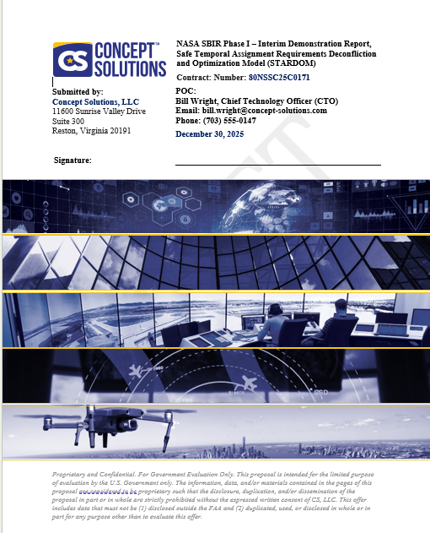
Interim Demonstration Report
Due 30 December 2025
We’ve started drafting the Interim Demonstration Report
  A quantitative description of the work performed
  An indication of any current problems, which may impede performance or impact program schedule or cost, and proposed corrective action
  A discussion of the work to be performed during the next reporting period
  A description of any changes to the planned use of subcontractors since contract award
  Estimated percentage of physical completion of the contract
Interim Demonstration Report (Draft)

Slide 8
STARDOM Progress
(29 Sept – Present)
Acquired the @Risk Software (License for 2 seats)
Evaluated potential venues for STARDOM
Built an air force / fleet of 6 aircraft
Developed a notional visualization of the STARDOM environment
  Started with a 2-Dimensional problem; One crossing point and 4 origin/destination points
Ran Monte Carlo simulations, examining the relationships between scheduled intervals, aircraft performance, and collision risk associated with STARDOM operations

Slide 9
Demonstration

Slide 10
STARDOM: Iterative Development
Update Parameters: AC Performance or interval
No
Generate aircraft with various RTP*
Schedule Flights
Generate uncertainty: departure, wind, AC performance
Run simulation
Acceptable?
Yes
Document Findings
*Required Time Performance: a performance metric describing the 95% confidence interval of arrival time accuracy for an aircraft

Slide 11
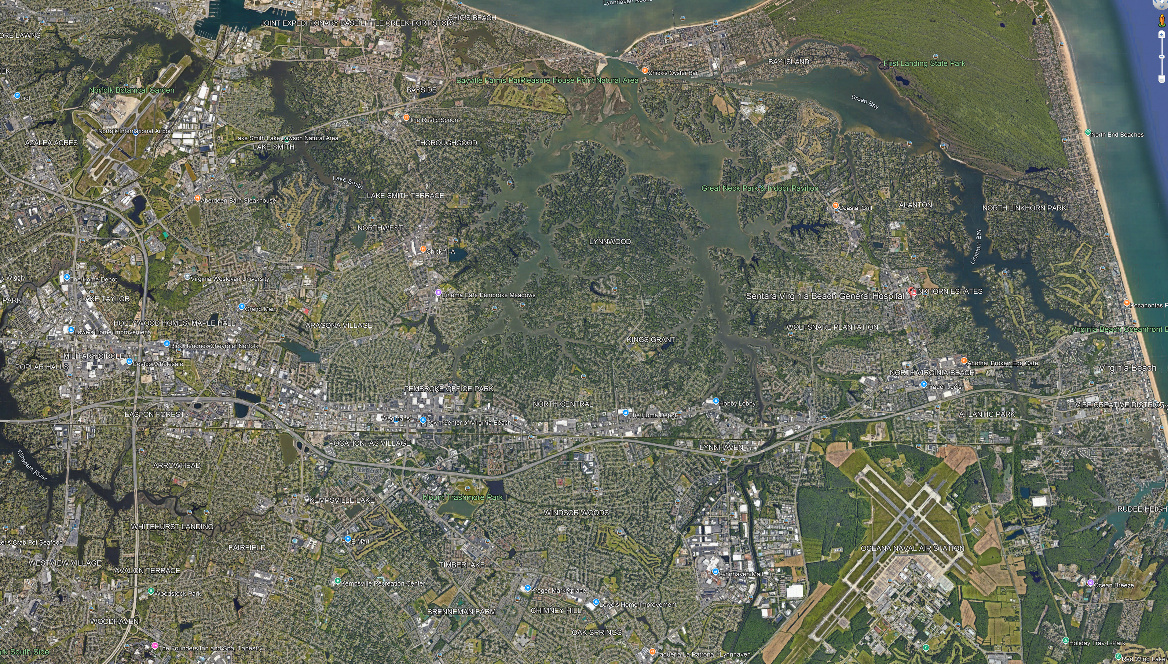
ORF
Kings
General
Convention
Westin

Slide 12
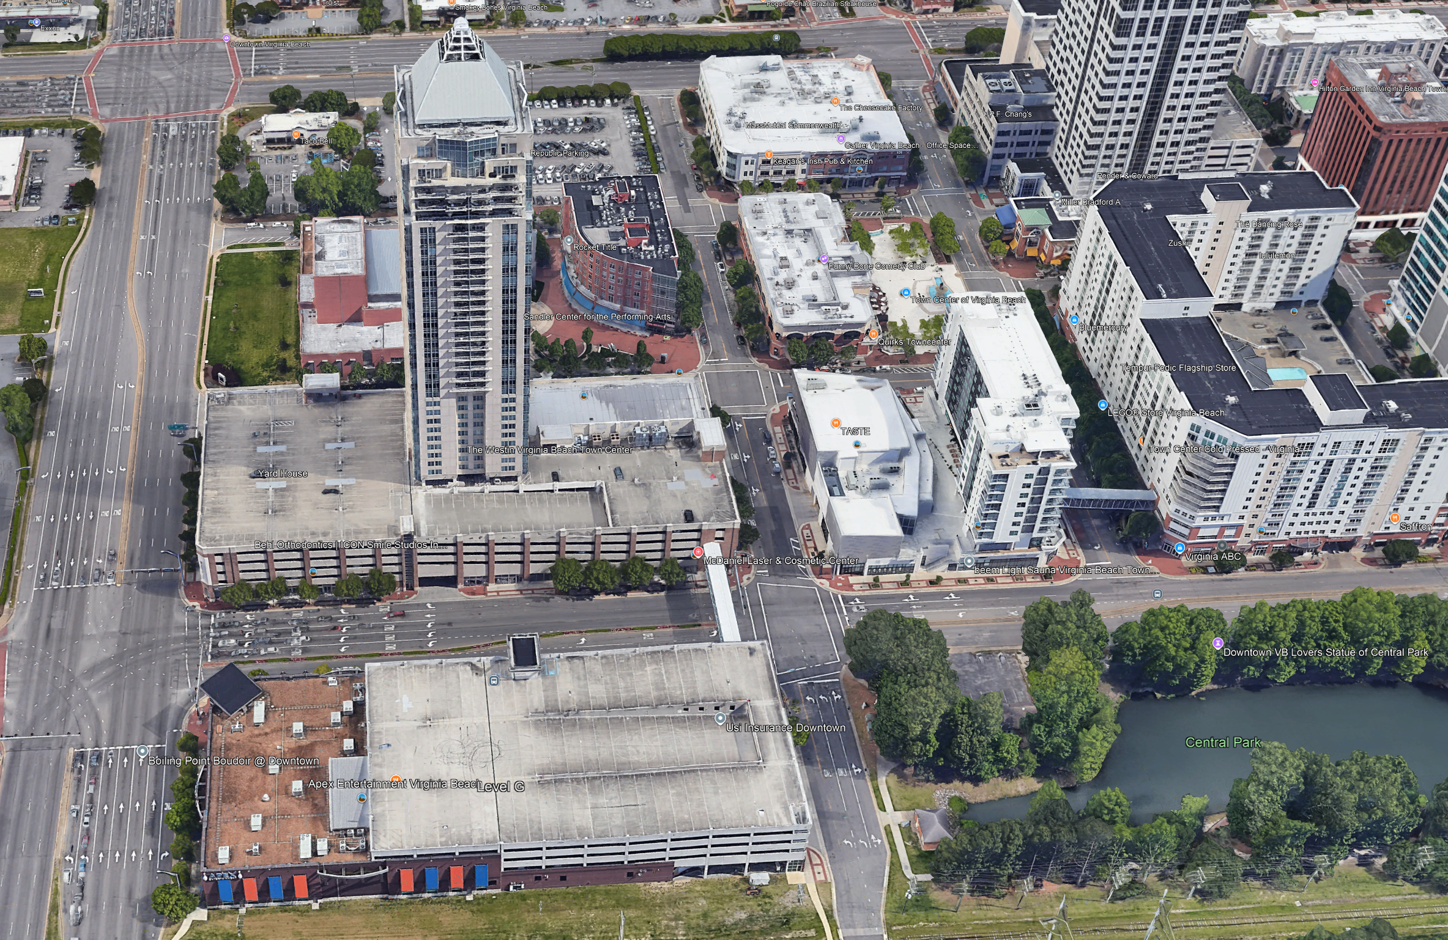
Westin
36:50:29
76:08:09

Slide 13
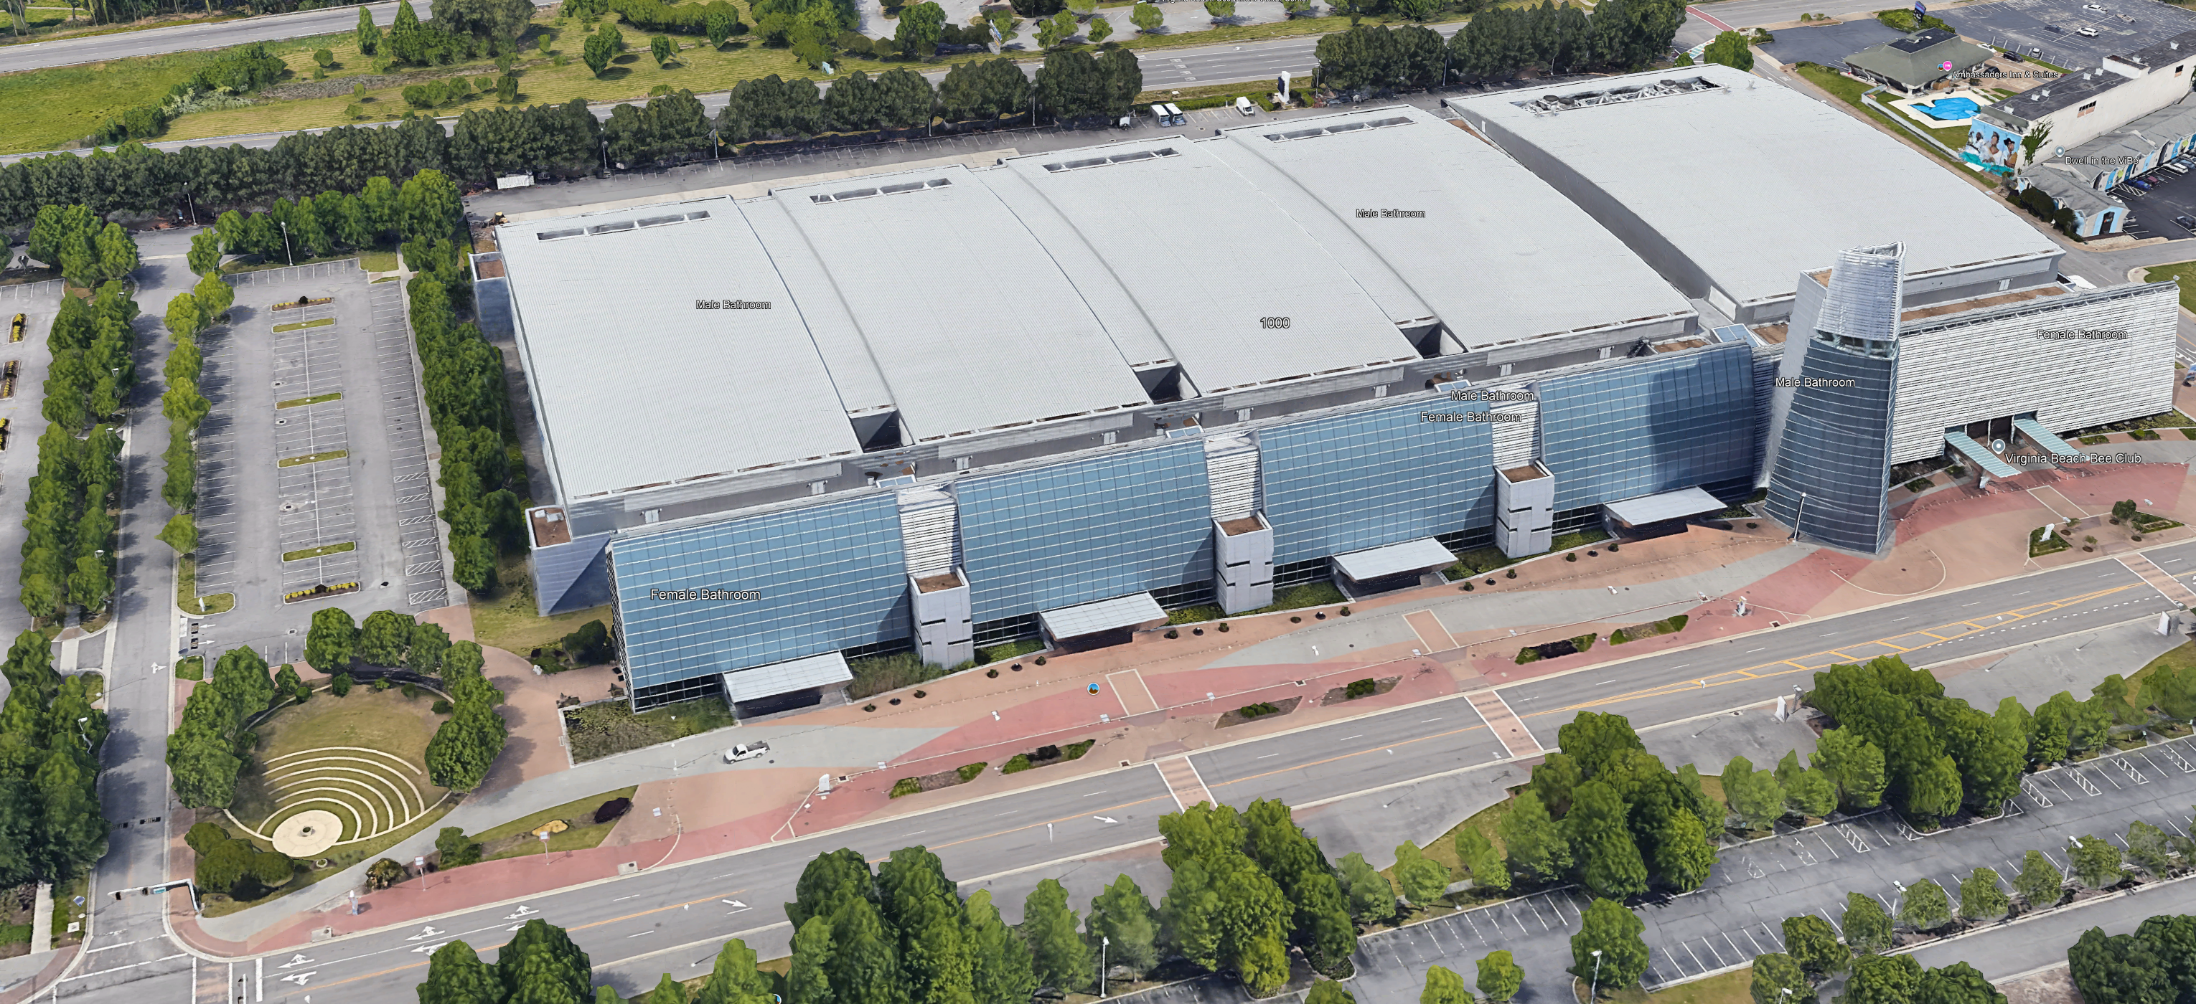
Convention
36:50:42.5
75:59:20.25

Slide 14
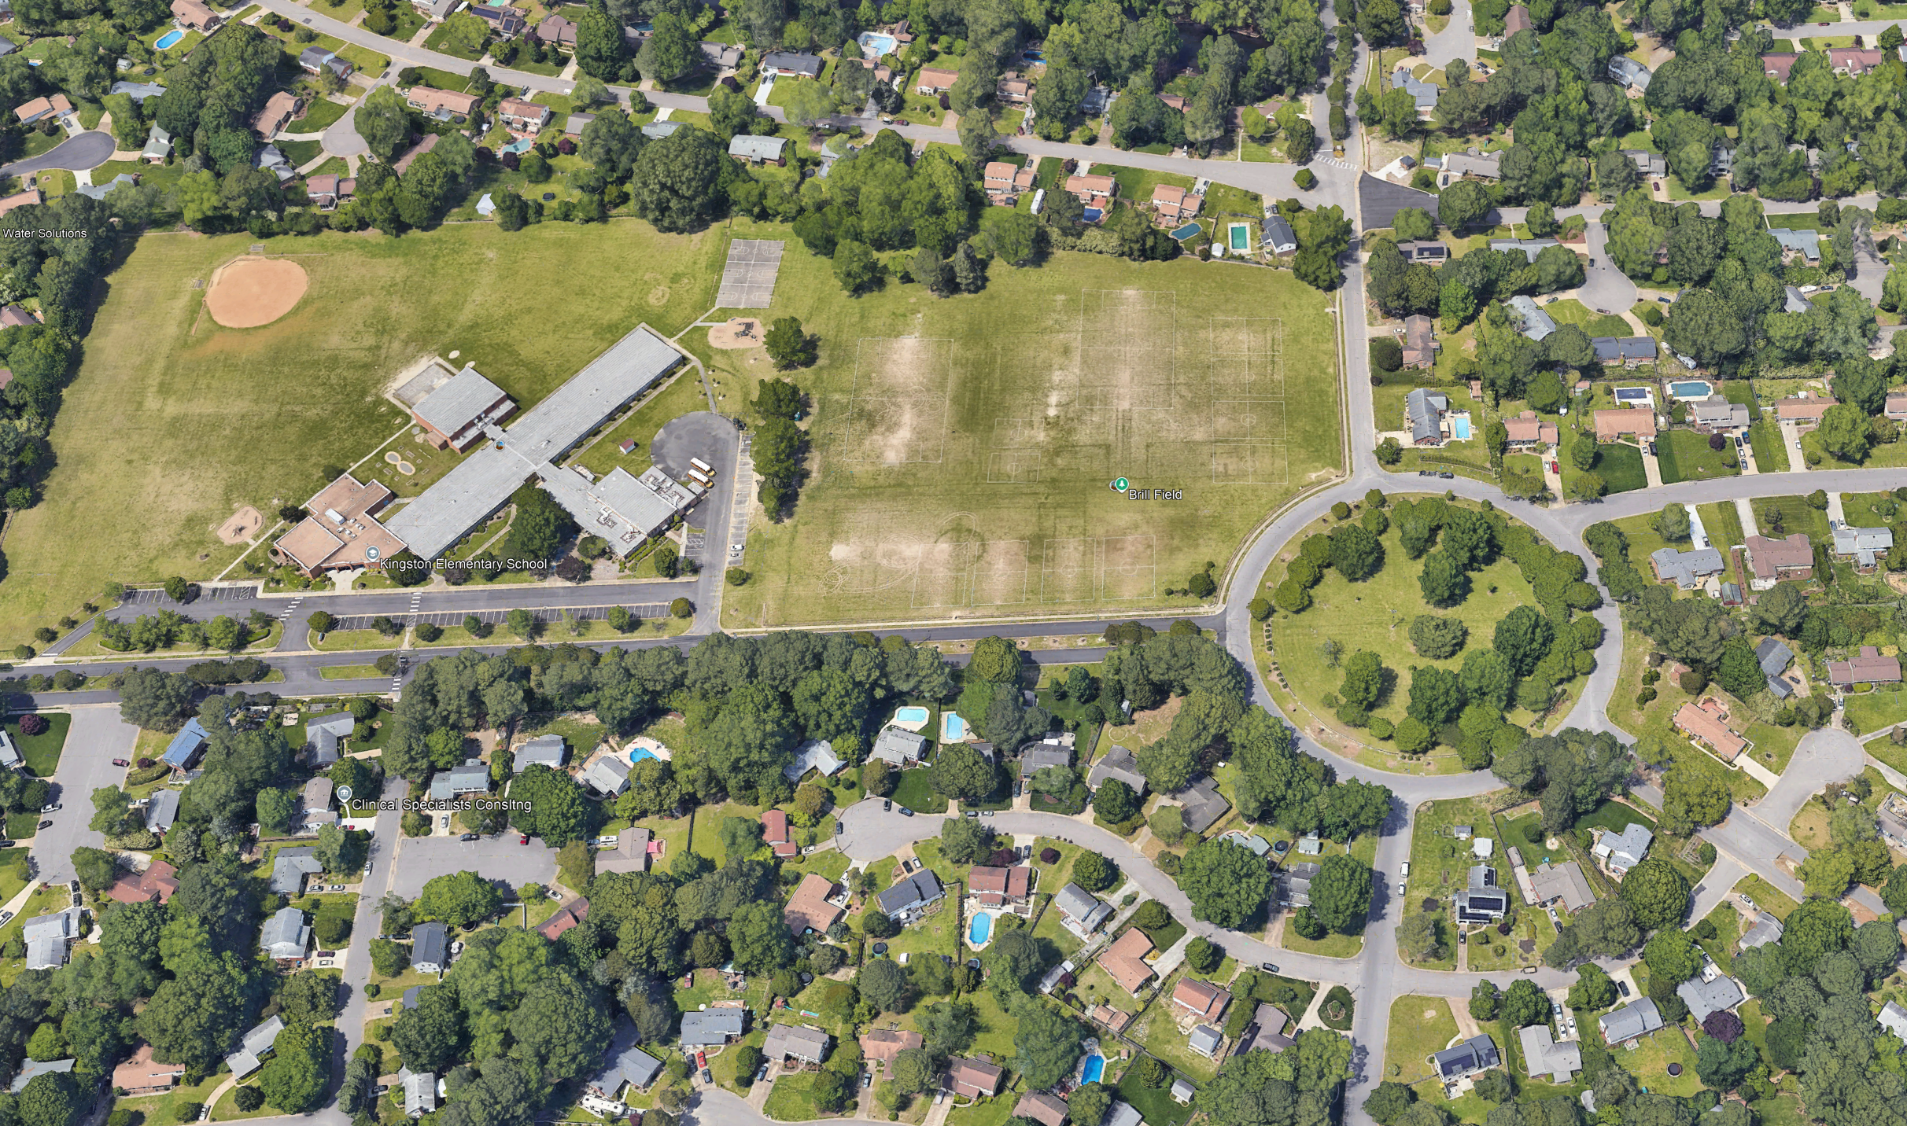
Kings
36:51:40.5
76:05:28

Slide 15
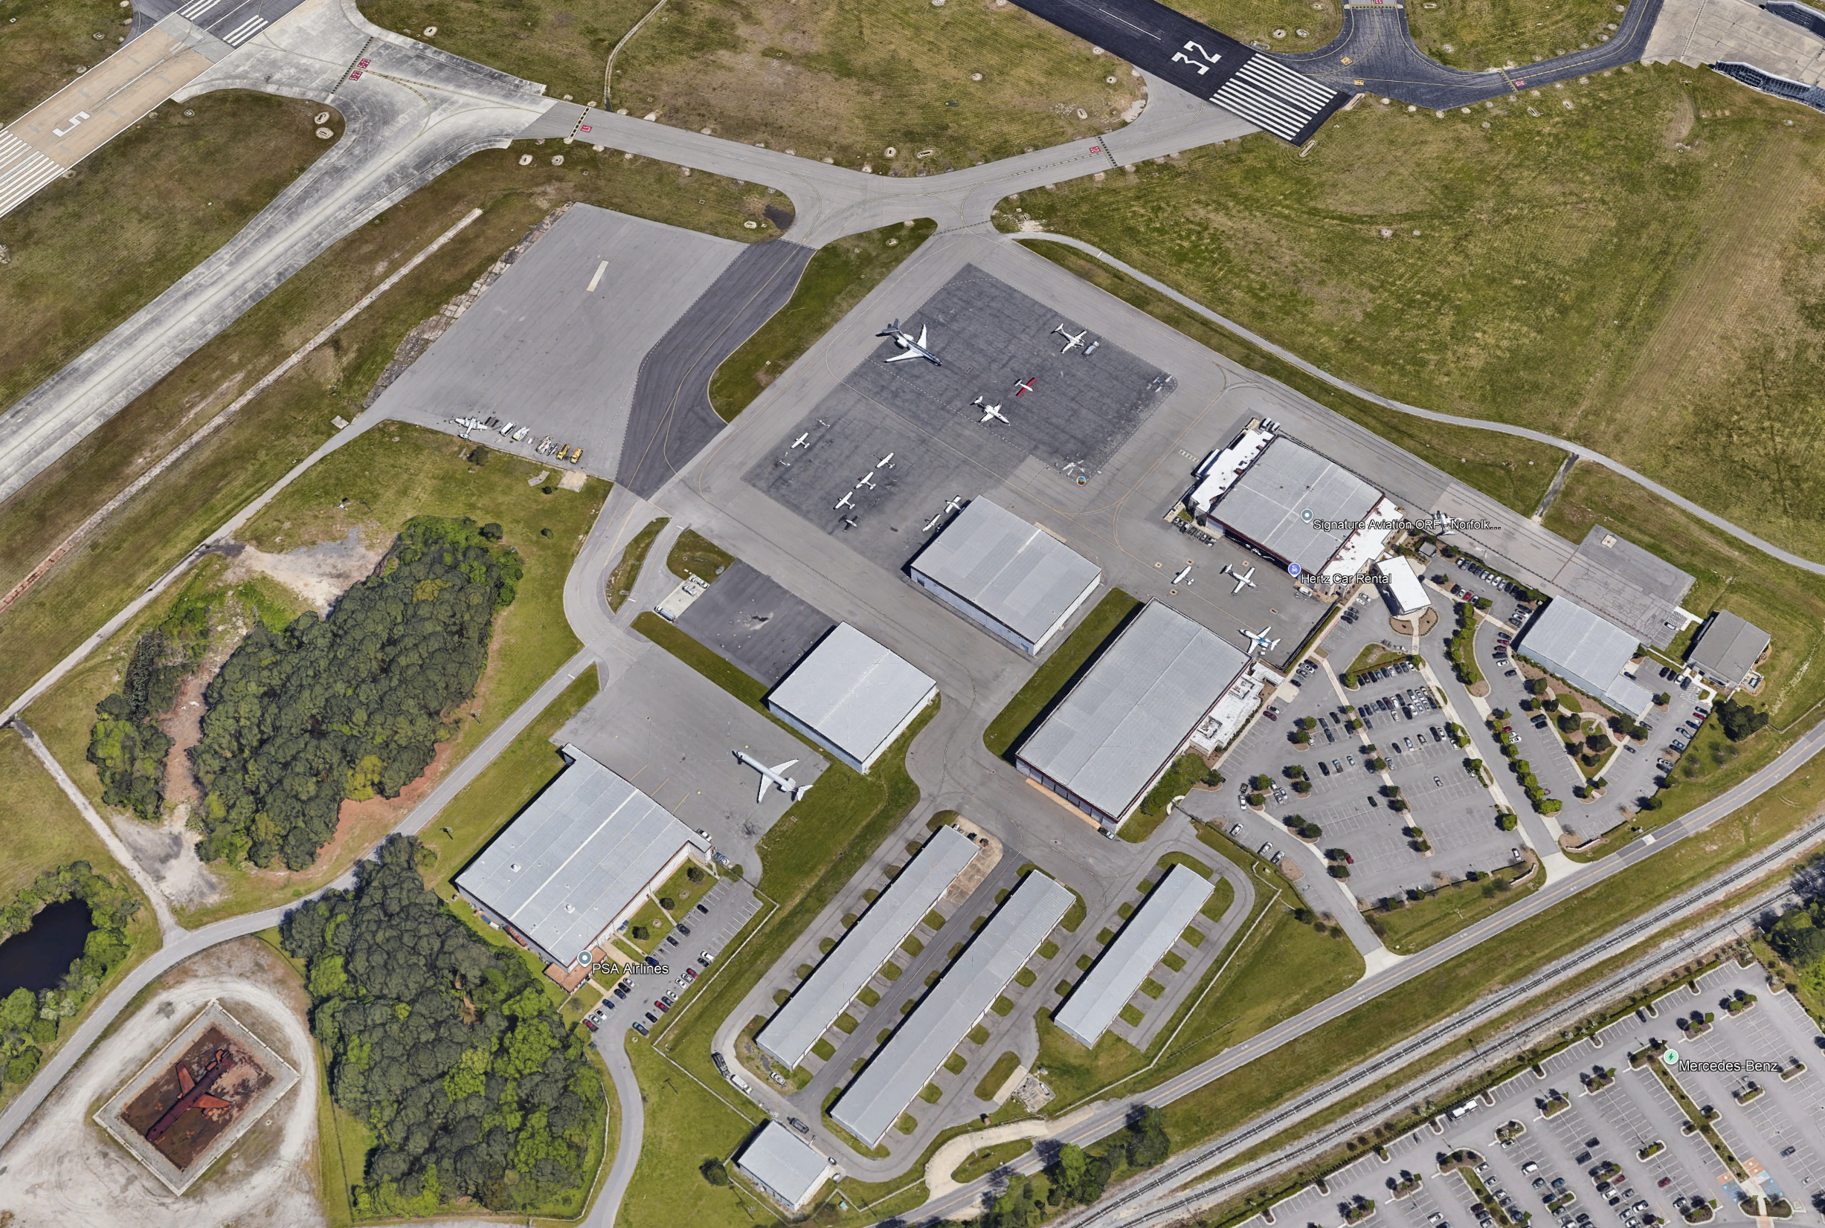
ORF
36:53:14.6
76:12:10

Slide 16
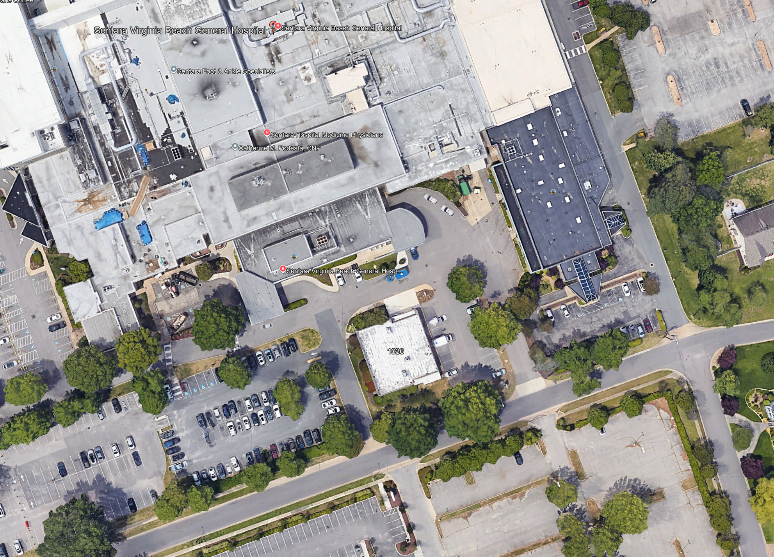
General
36:51:49.7
76:01:32.8

Slide 18
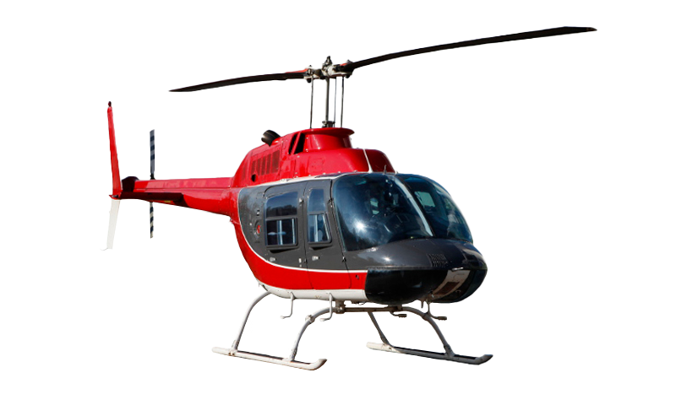
ORF
08:07:35
08:00
08:07:27
Kings
General
08:09:00
08:09:08
08:04:34
08:04:31
Convention
Westin
08:14:00
08:01
08:14:07

Slide 19
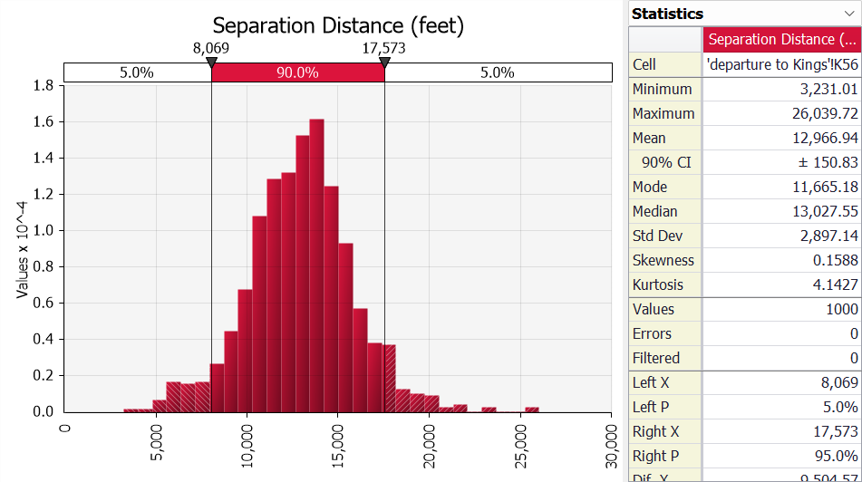
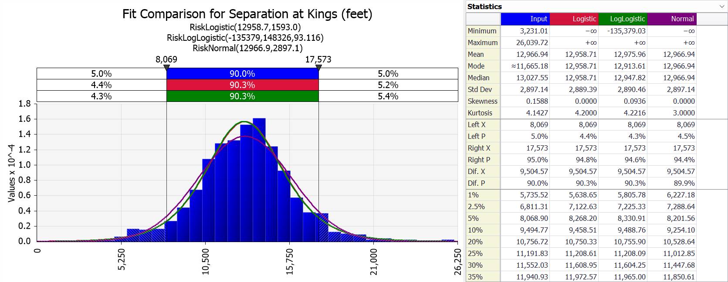
Aircraft 1 radius: 25’
Aircraft 2 radius: 30’
Collision = separation < 55’
P(separation < 55) = 4.16 e-6
~ 1 in every 250,000 crossings

Slide 20
Sponsor Input /Feedback

Slide 21
Next Steps

Slide 22
Backup Charts

Slide 23
STARDOM Venue Selection (1 of 2)
Considered several candidate cities – not too large and not too small – using a range of factors
  Reno, NV
  Virginia Beach, VA
  Chula Vista, CA
  Daytona-Springfield, OH
  Grand Forks, ND
  Wichita, KS

Slide 24
STARDOM Venue Selection (2 of 2)
Factors considered in venue selection
  UAM corridor variety
  Test range/facility access
  Partner readiness
  Weather reliability
  Airspace complexity (fit for study)
  Data availability/openness
  Ground risk manageability
  Regulatory/stakeholder alignment

