Slide 1
ATM Enterprise Risk & Operational Gap (AERO) Assessment
Runway Separation Services

Slide 2
AERO Process – Executive Summary
Legacy Practice → Bottom Up: Identify Individual Operator Needs
AERO → Top Down: Enterprise Level Needs
Enterprise Architecture Viewpoints
Map Architecture to NAS systems, Services, & Operations
Data-Driven Analysis to Identify Gaps
Propose ONA(s) for Consideration

Slide 3
Key Findings
Virtually no occurrences attributed to lack or failure of ATM Systems
Most common failures: Human Projection & Cognition
  Inability to accurately project future location of vehicles, aircraft
  Confusing or forgetting information

Slide 4
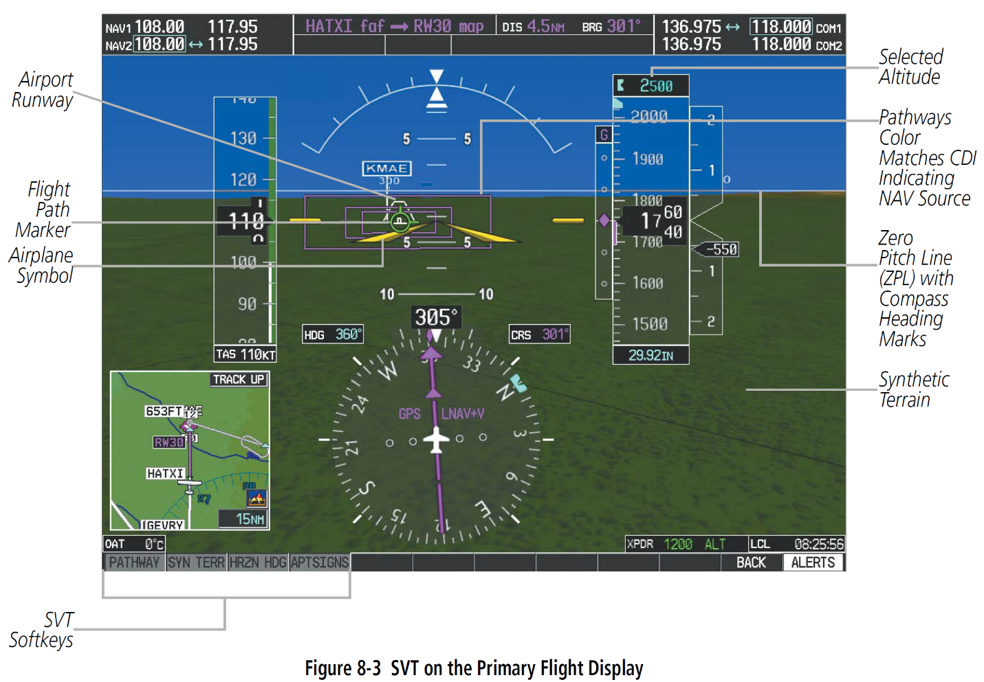
Potential ONA 1 – Controller Projection Tools
Tools to support controller short term predictions
  Continuously computed vector information, predicted separation

Slide 5
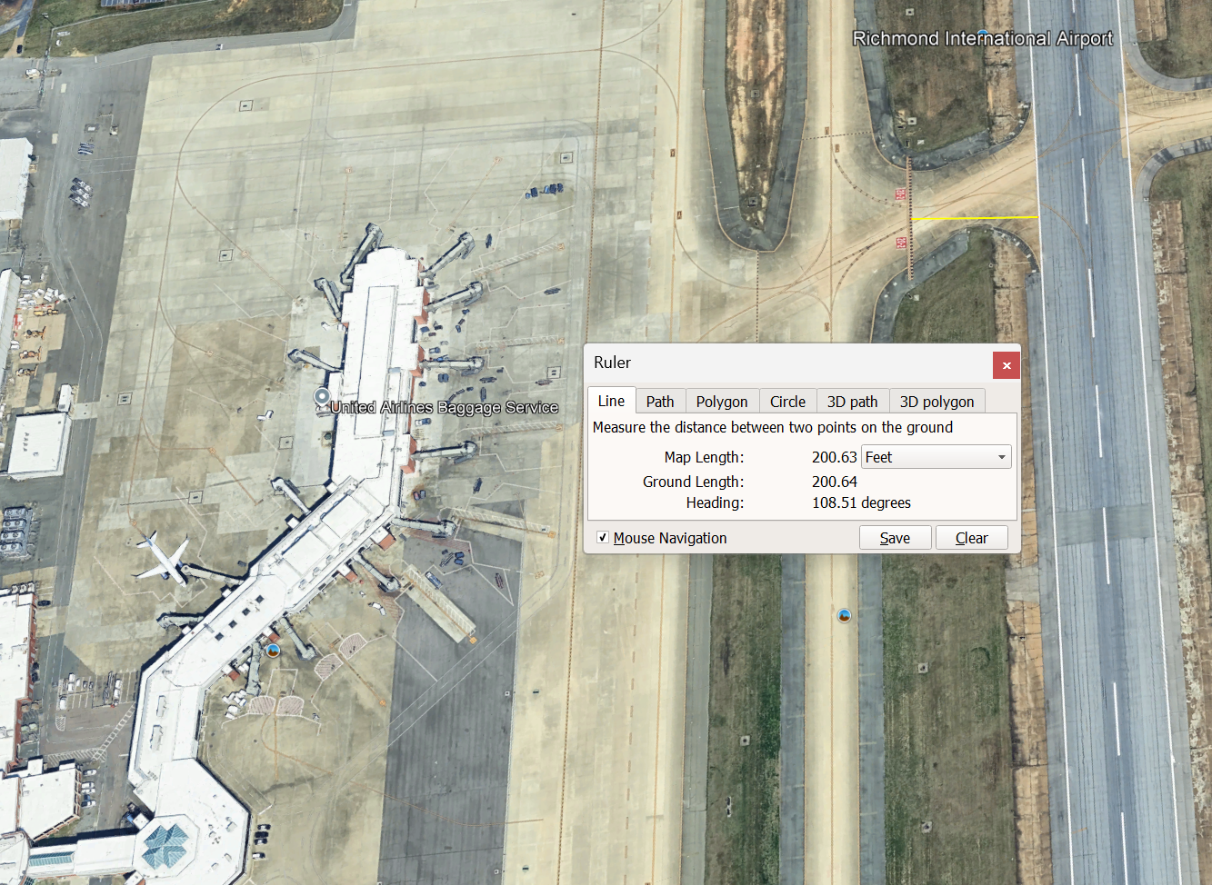
Potential ONA 2 – Runway Exit Lines

Slide 6
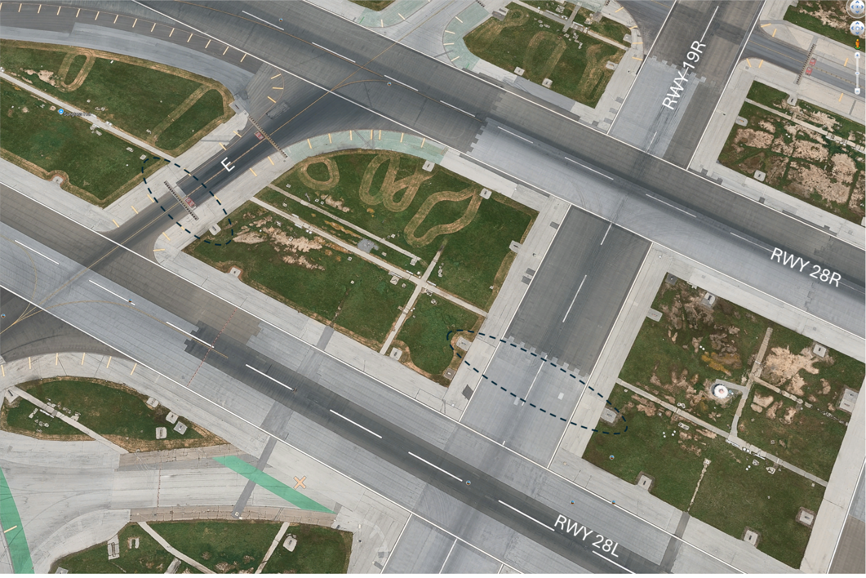
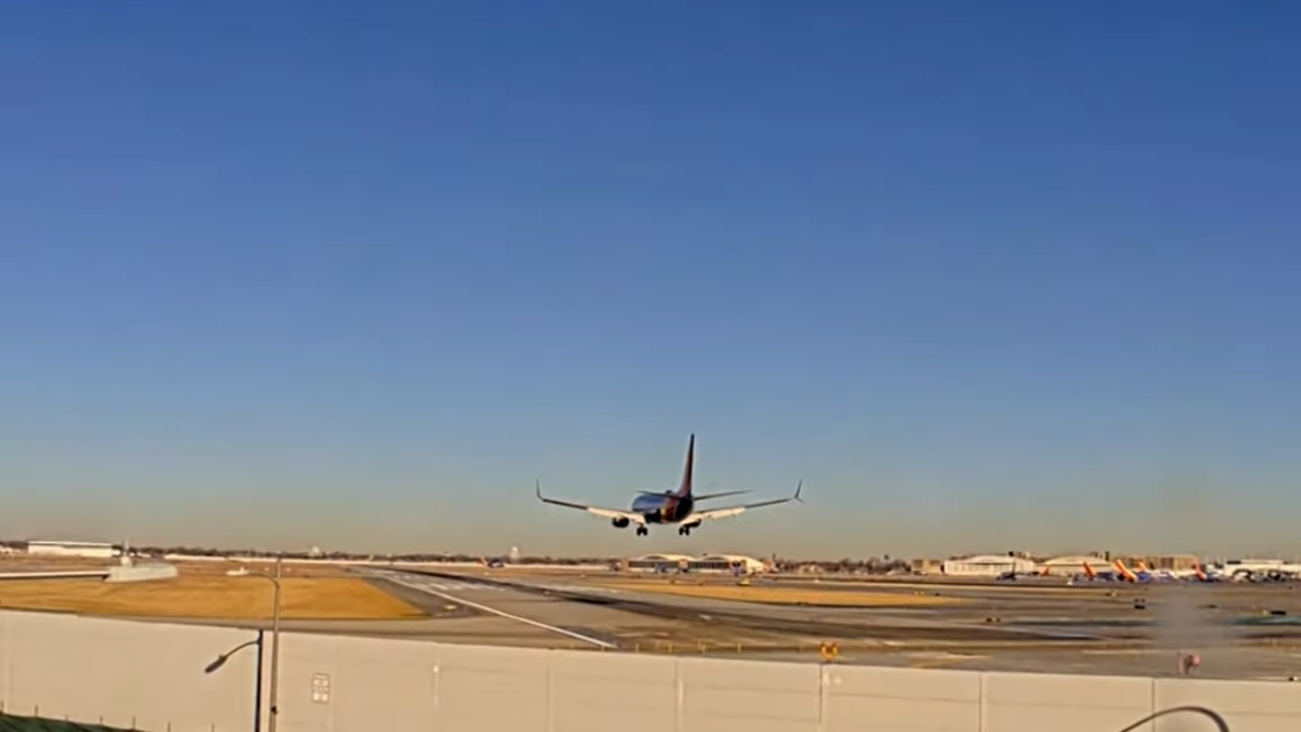
Potential ONA 3: Using Runways as Taxiways
Advisory Circular 150/5300-13B states that “using runways as a taxiway introduces an elevated risk to operational safety.”
Tradeoff assessment should compare efficiency savings to expected costs of a runway collision
ONA might find that this procedure is not an operational need

Slide 7

Potential ONA 4 – Communication / Identification
GA Call Signs are hard to remember, easy to confuse
Richmond RVA Flyers fly Diamond DA-40 aircraft with these call signs:
  N502RF
  N503RF
  N531RF
  N602RF
  N702RF
Military and Commercial aircraft use intuitive, easy-to-remember call signs

Slide 8
Questions?

