Slide 1
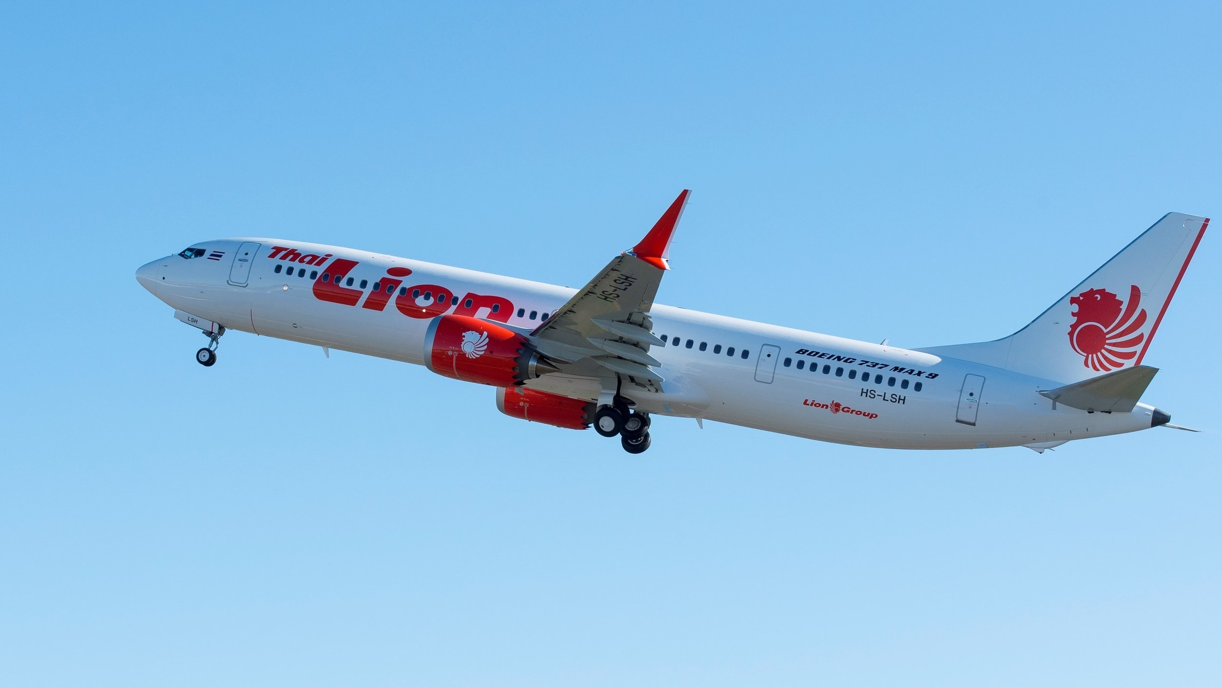
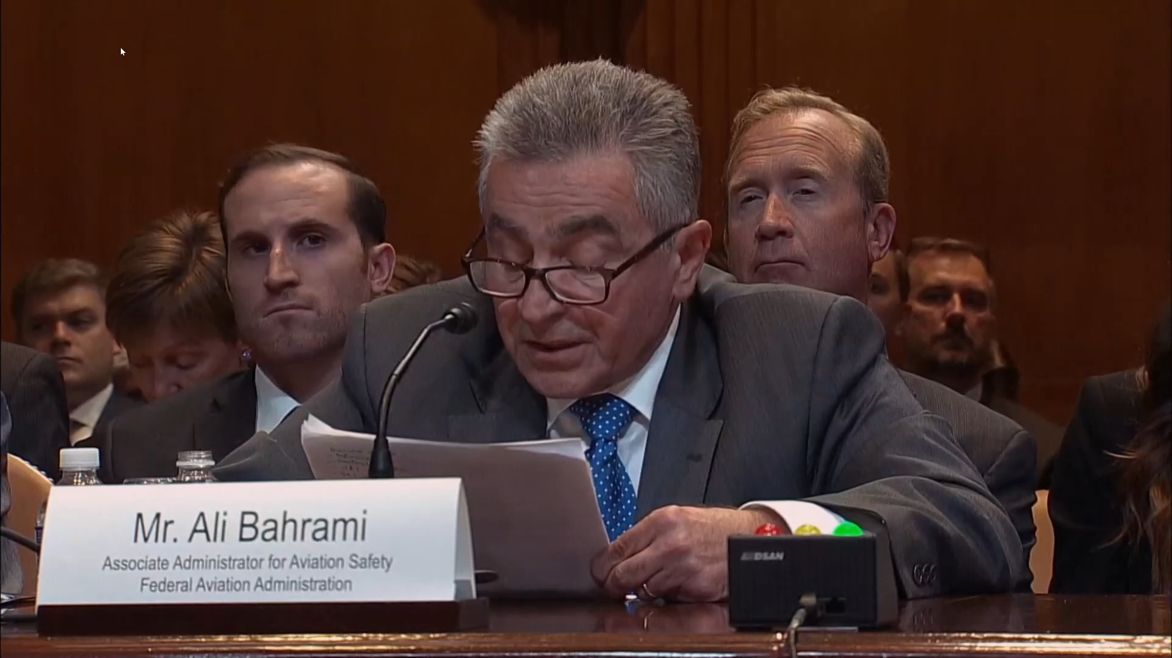
ALR
Gambling with High Risk
“this approach [ALR] exposes the public to a level of risk that normally would not be tolerated, but for a short, defined period (i.e., limited exposure). The purpose of this exception is to allow operations to continue by controlling exposure while mitigations are developed and implemented.” (rejected guidance for 8040.4C, Oct 2021)
MCAS ALR Calculations
“Quantitative risk of 1 × 10⁻⁷ per flight hour meets the interim severity level 1 risk limit. If the 383-aircraft worldwide fly an average of 9 flight hours per day, a 150-day exposure period (517K flight hours) results in a 95% chance of no accident”

